Slide 1
INSTRUCTIONS
Use Font size 22 to 28 and Font Style Times New Roman (body)
Do not change the Template: Heading / Title of the slides
Do not change font style or colours
Do not copy paste paragraphs: use only Bullet Points
Maximum slide Limit is 20 only
As per the number of supervisor allotted adopt slide-2 or slide-3
Please display the required meaningful Content or images or tables
Change the footer accordingly using insert tab then click on header & footer tab and edit it
Save the PPT with Register No, Dept and Review no, example: 23xxxxxxxxx_CSE

Slide 2

Title: Heritage and Culture History Of India
Student Name: P.Laxman Raj Teja
Student ID: 2520090064
Cluster:03
Section: 11
Under the Guidance
of
Supervisor Name:Jayaram boga
Assistant Professor
Department of CSE

Slide 3
OUTLINE
Abstract
Existing System
Proposed System
System Architecture
Project Modules
Objectives
Co’s Attainments - FWD
Co1
Co2 …….. 5. Co5
Co’s Attainments - DSA
Co1
Co2 …….. 5. Co5
Screen Shots for FWD & DSA
Conclusion
Geo-Tagged Photos

Slide 4
Abstract
The Global Heusing HTML, CSS, and JavaScript. The main objective of this project is to present news, reports, and articles related to heritage, culture, traditions, arts, and ritage & Culture Journal is a dynamic journalism website developed historical monuments in an interactive and visually engaging manner.
The website highlights important heritage sites, classical arts, folk traditions, festivals, and cultural preservation efforts. It includes advanced design elements such as animated backgrounds, scrolling news ticker, interactive like system, timeline section, and real-time date and time display. These features enhance user engagement and provide a modern digital journalism experience.
The project demonstrates the effective use of front-end web technologies to build a responsive and content-rich journalism platform. It also emphasizes the importance of preserving cultural identity and spreading awareness about heritage conservation through digital media.
Overall, this website serves as an informative and interactive platform for promoting global heritage and cultural journalism.

Slide 5
Existing System
🖱 Expandable Information Cards –
Users can click on each history topic card to expand and read detailed information about that period.
The website presents major historical periods like the Indus Valley Civilization, Maurya Empire, Gupta Empire, and the Indian Independence Movement.
🌙 Dark Mode Feature –
The website allows users to switch between light mode and dark mode for better viewing experience.
💻 Responsive Web Design –
The layout adjusts automatically for mobile, tablet, and desktop screens using CSS.
🎨 Modern User Interface – The website uses styled cards, shadows, hover effects, and smooth transitions to create a clean and professional look.
📚 Educational Content System –
Each section provides structured information about Indian heritage, culture, empires, and important historical developments.
⚡ JavaScript Interactivity –
JavaScript functions are used to control card expansion, dark mode toggle, and dynamic elements like the footer year.
🧭 Simple Navigation Structure –
The page organizes historical topics clearly so users can easily explore different parts of Indian history.

Slide 6
Proposed System
📜 Interactive History Learning Platform –
The system provides an interactive website where users can explore different periods of Indian history such as the Indus Valley Civilization, Maurya Empire, Gupta Empire,
and the Indian Independence Movement.
🖱 Expandable Content System –
Users can click on history cards to expand and read detailed information about each historical period.
🌙 Dark Mode Feature –
The proposed system includes a dark mode option to improve readability and provide a modern user interface.
🤖 History Question Bot –
A chatbot feature allows users to ask questions about Indian history and receive quick responses.
📚 Educational Content Organization –
The system organises information about Indian culture, heritage, empires, and historical events in a structured format.
💻 Responsive Design –
The website is designed to work on different devices such as mobile phones, tablets, and computers.
⚡ Interactive Web Features –
JavaScript is used to provide dynamic features like card animations, content expansion, and interactive elements.
🎓 Student Learning Support –
The system aims to help students easily learn and understand Indian history through an engaging and user-friendly platform.

Slide 7
System Architecture
User Layer – The user accesses the website through a web browser and interacts with the system by clicking history cards, using dark mode, and asking questions.
Frontend Interface – The website interface is developed using HTML to structure the historical content and sections.
Design Layer – CSS is used to style the website with colors, card layouts, animations, and dark mode for better user experience.
Interaction Layer – JavaScript manages interactive features such as card expansion, dark mode toggle, and chatbot responses.
Content Module – The system displays educational information about topics like the Indus Valley Civilization, Maurya Empire, Gupta Empire, and the Indian Independence Movement.
Expandable Card System – Each history section is presented in interactive cards that expand when clicked to reveal detailed information.
Chatbot Module – A simple history chatbot allows users to ask questions and receive predefined answers about Indian history.
Output Layer – The system displays the requested information and responses on the webpage, allowing users to learn about history in an interactive way.

Slide 8
Project Modules
User Interface Module Provides an interactive interface for users to explore Indian history topics. Allows easy navigation between sections like ancient history, empires, culture, and independence movement.
Login & Authentication Module Allows users to log in to access the website features. Ensures basic user authentication before entering the main history portal.
Ancient History Module Provides information about early Indian civilizations such as the Indus Valley Civilization. Displays images and descriptions of ancient culture, cities, and lifestyle.
Indian Empires Module Shows details about powerful Indian empires like the Maurya Empire and the Gupta Empire. Explains their rulers, achievements, and historical importance.
Culture & Heritage Module Displays information about Indian traditions, arts, and cultural heritage. Includes details about classical dance, architecture, and historical monuments.
Independence Movement Module Explains the events and leaders involved in the Indian Independence Movement. Provides historical images and important milestones of the freedom struggle.
Interactive Features Module Includes animations, image sliders, and clickable cards for better user engagement. Provides features like dark mode and animated timeline for exploring history.
AI Chatbot Module Allows users to ask questions about Indian history. Provides automated answers to help users learn historical facts easily.

Slide 9
Objectives
Here are 8 Objectives for your Interactive Indian History Website Project:
To develop an interactive educational website that helps users learn about Indian history in an easy and engaging way.
To provide structured information about ancient civilizations such as the Indus Valley Civilization.
To explain the rise and achievements of major Indian empires like the Maurya Empire and the Gupta Empire.
To increase awareness of Indian culture and heritage, including traditions, arts, and festivals.
To present information about the Indian freedom struggle, especially the Indian Independence Movement.
To make learning history more interactive using features like expandable cards and dynamic content.
To improve user experience through modern web features such as dark mode and responsive design.
To create a simple question-answer system where users can ask questions about Indian history using a chatbot.

Slide 10
Co’s Attainments - FWD
CO1
Understand Internet fundamentals, HTTP/HTTPS protocols, and web client-server architecture.
Explain browser functionality, developer tools, web hosting, and domain concepts.
Apply HTML document structure and basic webpage elements such as lists, links, and images.
CO2
Design structured web pages using HTML forms, semantic tags, tables, and media elements.
Apply CSS styling techniques including selectors, typography, colors, and spacing.
Implement modern layout techniques using Flexbox, CSS Grid, and responsive design.
CO3
Apply JavaScript fundamentals including variables, operators, conditions, loops, and functions.
Work with arrays, objects, and ES6 features for efficient programming.
Implement functional programming concepts such as arrow functions and callbacks.
CO4
Perform DOM manipulation and event handling to create dynamic web pages.
Use browser storage such as localStorage and sessionStorage for client-side data.
Implement asynchronous programming using Promises, fetch(), async, and await.
CO5
Implement form validation and API integration using JavaScript.
Apply performance optimization techniques and SEO practices for web applications.
Deploy responsive and interactive web applications with improved usability.

Slide 11
Co’s Attainments - DSA
CO1
Analyze problem statements using asymptotic notation (Big-O, Ω, Θ).
Compare algorithm efficiency based on time and space complexity.
Implement and evaluate searching and sorting algorithms in Java.
CO2
Design and implement Abstract Data Types (ADTs) using arrays and linked lists.
Perform operations such as insertion, deletion, searching, and traversal.
Evaluate advantages and limitations of different data structures.
CO3
Apply stacks and queues to solve real-world workflow problems.
Implement circular queues, deques, heaps, and priority queues.
Analyze performance compared to other linear data structures.
CO4
Design hash-based data structures using hashing techniques.
Implement hash tables with chaining and open addressing.
Utilize Java Collections (List, Queue, Deque, Map) for efficient solutions.
CO5
Develop practical applications using linear data structures.
Implement data structures to solve real-world computational problems.

Slide 12
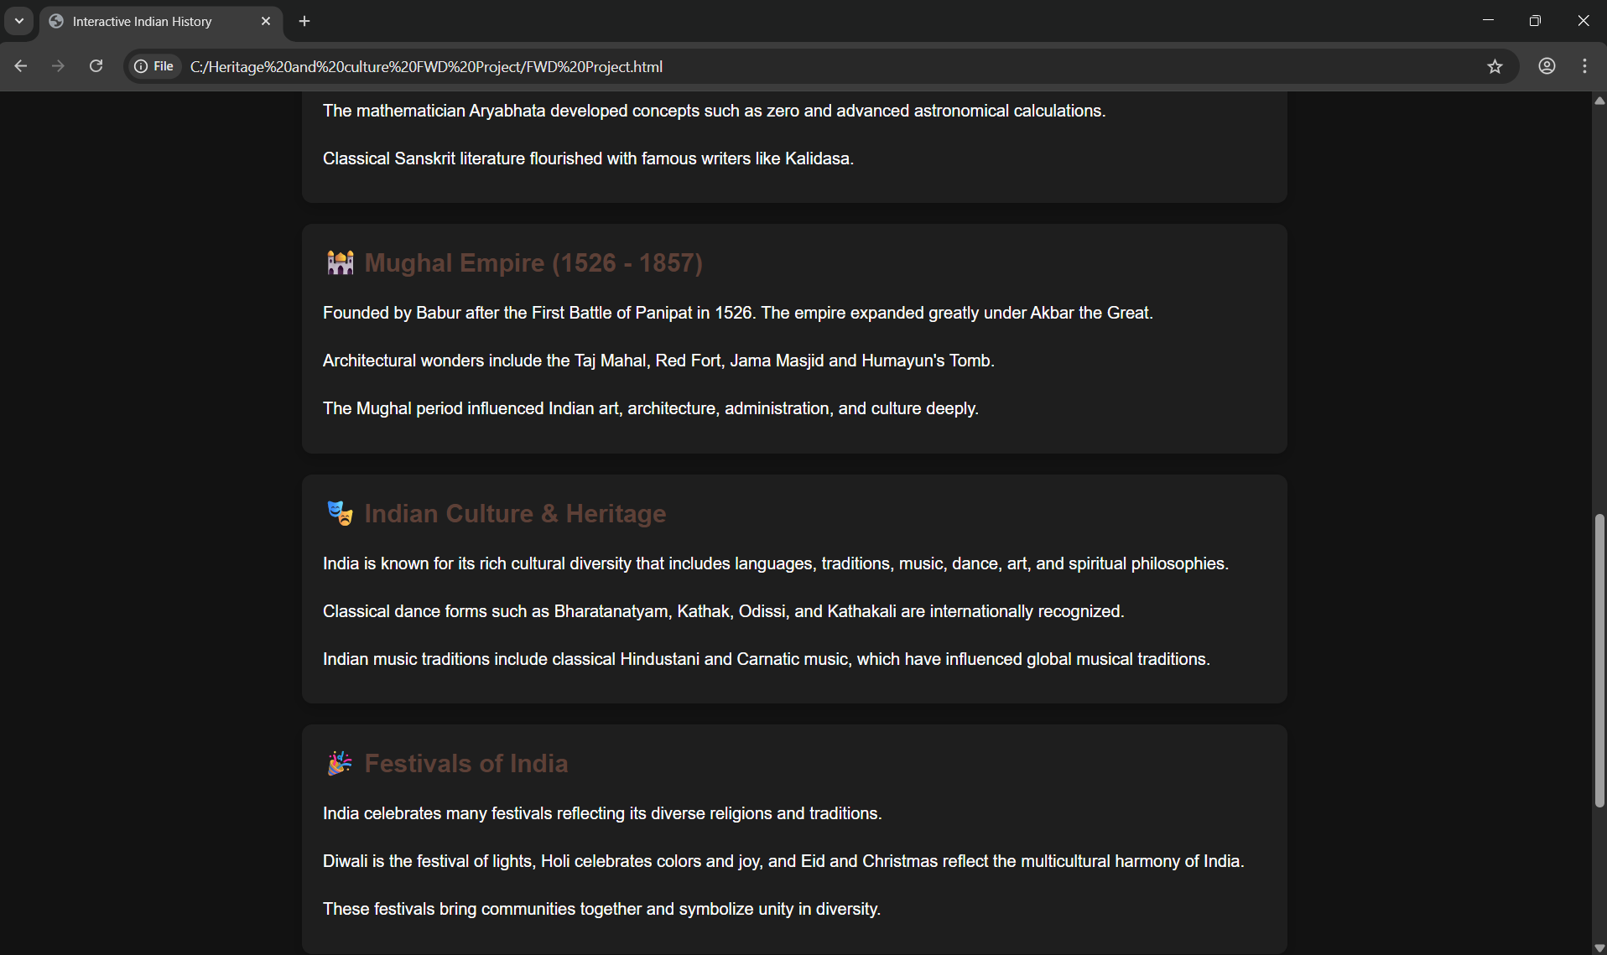
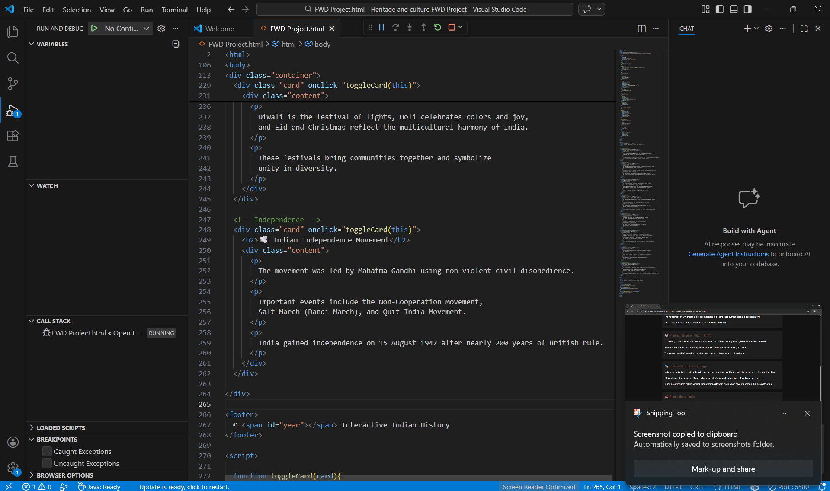
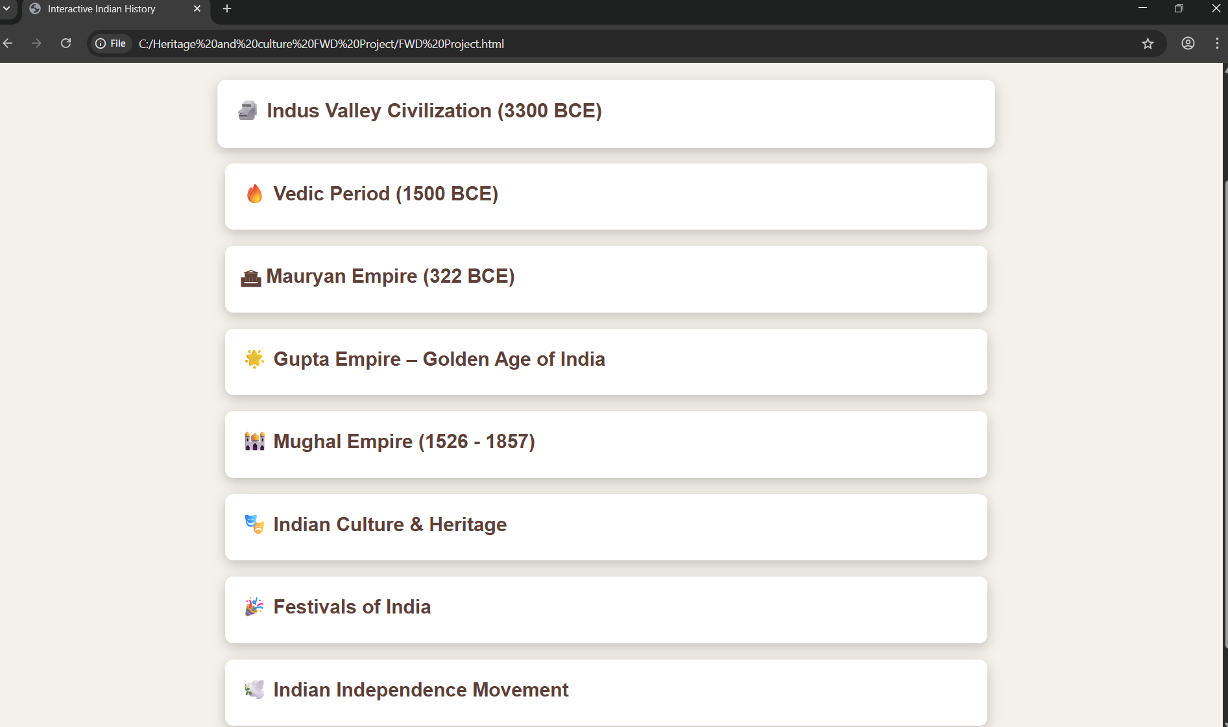
Screenshots for FWD & DSA

Slide 13
Conclusion
The Interactive Indian History Website project successfully presents important historical information in a modern and engaging way using HTML, CSS, and JavaScript. The website provides users with structured knowledge about major periods of Indian history such as the Indus Valley Civilization, the Maurya Empire, the Gupta Empire, and the Indian Independence Movement.
Through interactive cards, dark mode, and an AI chatbot, the system makes learning history more dynamic and user-friendly. The expandable sections allow users to explore historical topics in depth, while the chatbot helps answer basic questions related to Indian history.
Overall, this project demonstrates how web technologies can be used to create an educational platform that combines historical knowledge, interactivity, and modern design. It can be further improved in the future by adding a real database, more historical content, interactive maps, and advanced AI features to make the learning experience even richer.

Slide 14
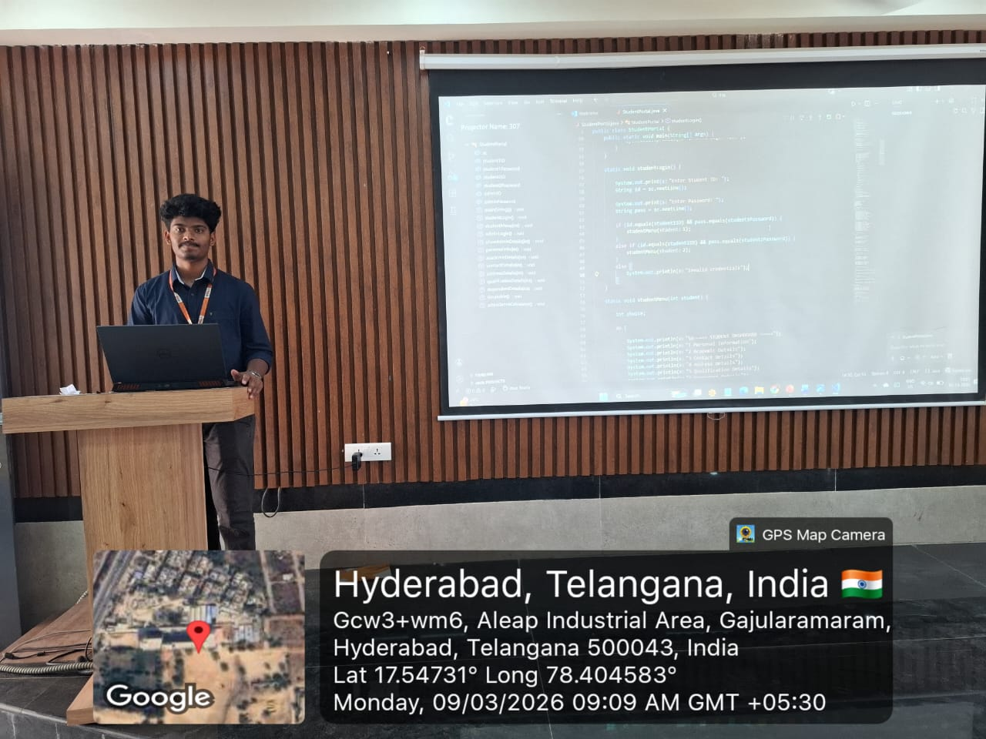
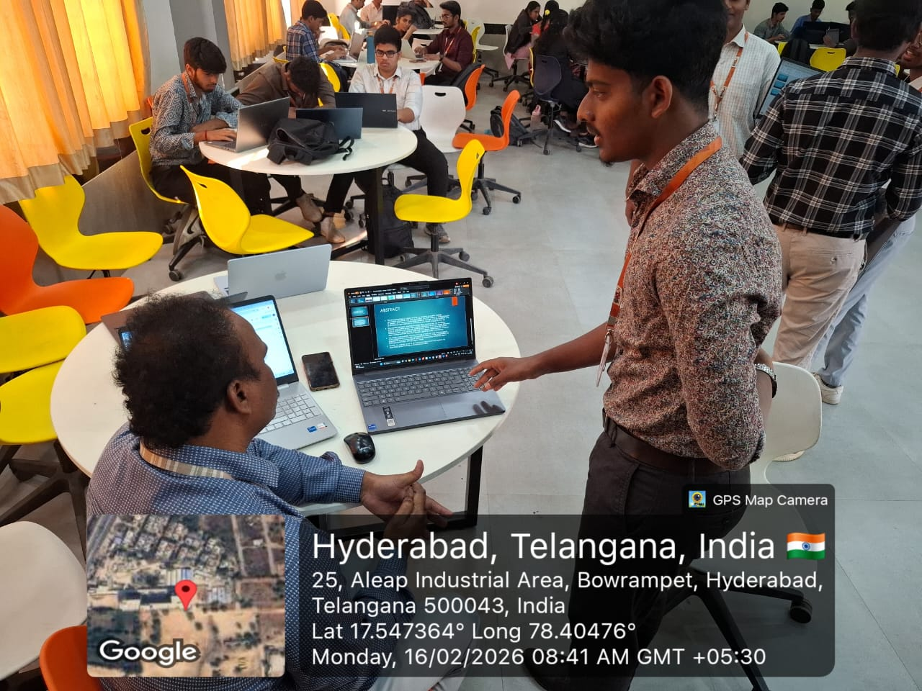
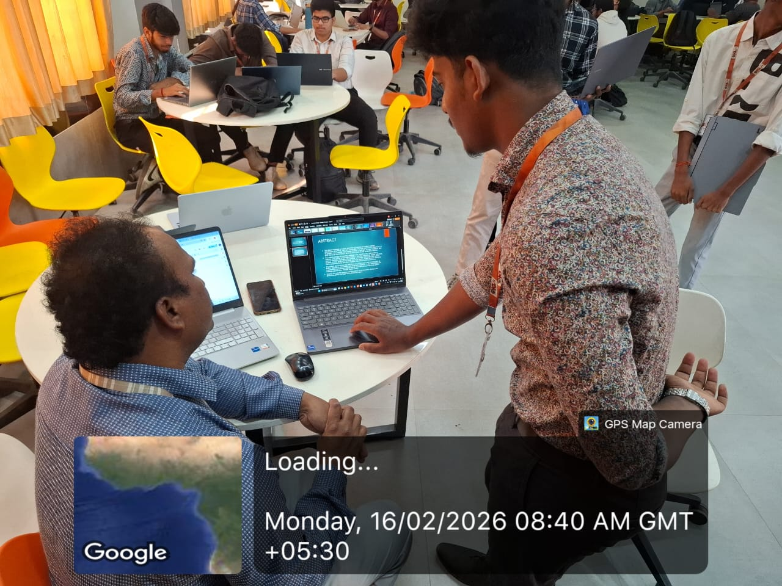
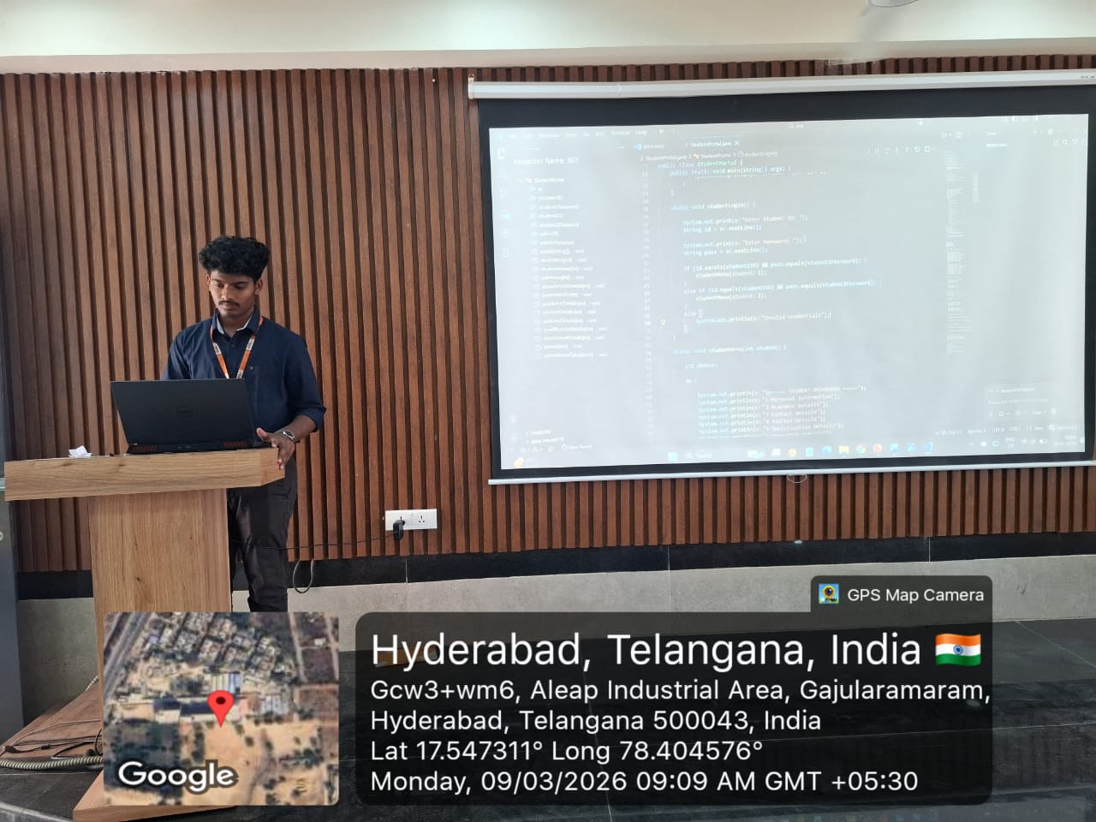
Geo- Tag Photos

Slide 15
THANK YOU

